Slide 1
CareCompass
Find Hospitals near you with one tap

Slide 2
Problem
As the ‘information’ increases, the filter between corrent and wrong blurs, and with a plethora of misinformation, its hard to find correct recommendations, be it a service or knowledge
The aim is to organise information for a selected field and provide a service for user to search through.

Slide 3
Proposed Solution
CareComfort utilises already available data from the net (google maps), and merges that with its own database.
It also allows service (Hospitals) to register themselves on the website.
User can then browse through this data with the heap of a Search feature and can also filter as per their requirement.

Slide 4
Features Proposed
Allows user to log in and register (Achieved)
Allows hospitals to register (Achieved)
Allows user to search through hospitals and view detailed information(Achieved)
Integrate google api to fetch hospitals from the web with real data (Achieved)
Allow user to save hospitals and view them in profile page (UI done, functionality incomplete)
Allows user to write reviews on a hospitals and shows other reviews(UI done, functionality incomplete)
Allow user to book appointment in desired hospitals(incomplete)

Slide 5
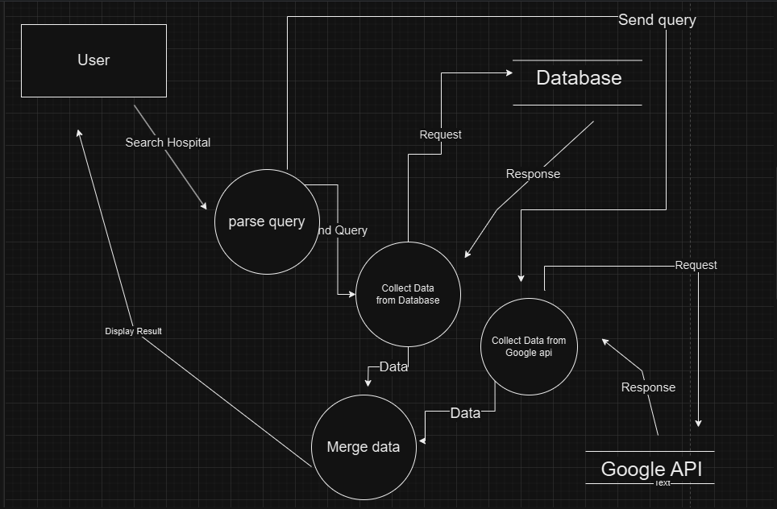
The Data flow
Level 1 DFD

Slide 6
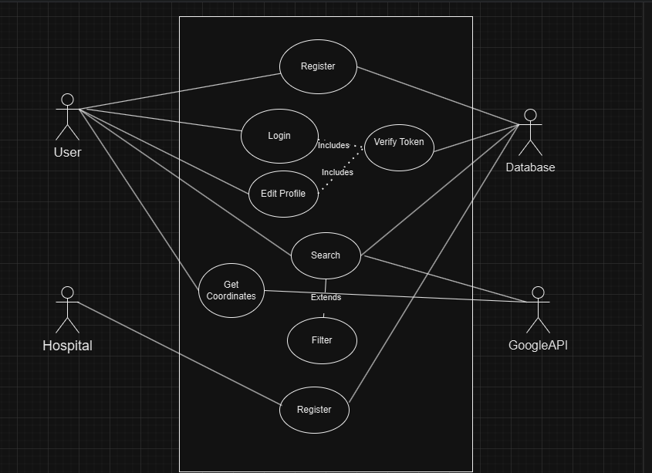
Use case Diagram displaying components

Slide 7
Technologies
Frontend: JavaScript, React.js, React Router, React-router-dom(for routing and page protection and to load skeletons), Axios (for api requests)
Backend: JavaScript (ES6+), Node.js,Express.js (for RESTful API
development) ,Prisma (mongodb model) , JSON Web Tokens (JWT) for
secure authentication
External APIs: Google Places API (for fetching hospital data based on location, getting coordinates and displaying Map and Pins)

Slide 8
Acheievment
Learned the basics of MERN stack and how to make a fully functional website.
Learned the interaction between each component in a medium scale application.
Learned how to make apis and to use External apis and integrate that with external data.
Created a functioning Search feature for hospitals which supports some filters.
Created and learned successful authentication and authorisation for user.

